Slide 1
Ensemble Techniques
Bagging
Boosting
Stacking

Slide 2
Ensemble Methods
Bagging : that often considers homogeneous weak learners, learns them independently from each other in parallel and combines them following some kind of deterministic averaging process
Boosting : that often considers homogeneous weak learners, learns them sequentially in a very adaptative way (a base model depends on the previous ones) and combines them following a deterministic strategy
Stacking : that often considers heterogeneous weak learners, learns them in parallel and combines them by training a meta-model to output a prediction based on the different weak models predictions

Slide 5
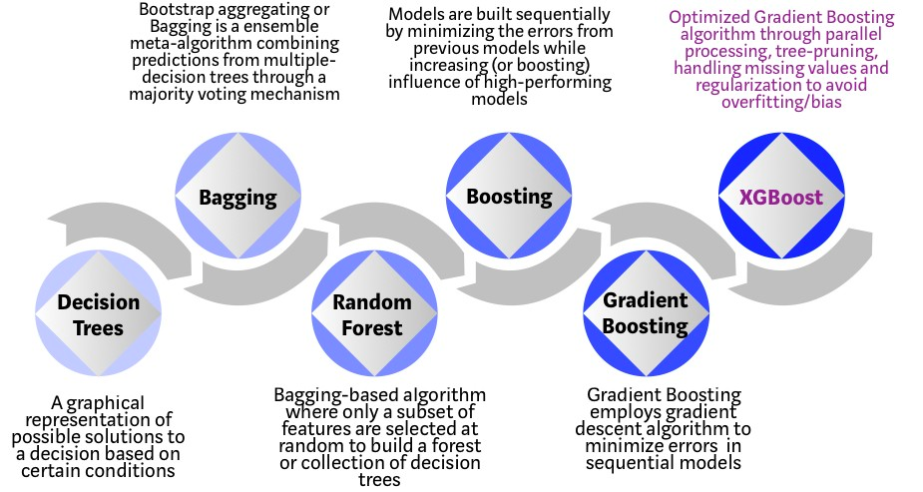

Slide 6
Bagging
One of the first ensemble methods to gain widespread acceptance used a technique called bootstrap aggregating or bagging for short.
Bagging generates a number of training datasets by bootstrap sampling the original training data. These datasets are then used to generate a set of models using a single learning algorithm. The models' predictions are combined using voting (for classification) or averaging (for numeric prediction).
Although bagging is a relatively simple ensemble, it can perform quite well as long as it is used with relatively unstable learners, that is, those generating models that tend to change substantially when the input data changes only slightly. Unstable models are essential in order to ensure the ensemble's diversity in spite of only minor variations between the bootstrap training datasets. For this reason, bagging is often used with decision trees, which have the tendency to vary dramatically given minor changes in the input data.

Slide 7
Bootstrap Method
The bootstrap is a powerful statistical method for estimating a quantity from a data sample. This is easiest to understand if the quantity is a descriptive statistic such as a mean or a standard deviation
Let’s assume we have a sample of 100 values (x) and we’d like to get an estimate of the mean of the sample.
We can calculate the mean directly from the sample as:
mean(x) = 1/100 * sum(x)
We know that our sample is small and that our mean has error in it. We can improve the estimate of our mean using the bootstrap procedure:
Create many (e.g. 1000) random sub-samples of our dataset with replacement (meaning we can select the same value multiple times).
Calculate the mean of each sub-sample.
Calculate the average of all of our collected means and use that as our estimated mean for the data.

Slide 8
Let’s assume we have a sample dataset of 1000 instances (x) and we are using the C5.0 algorithm. Bagging of the C5.0 algorithm would work as follows.
Create many (e.g. 100) random sub-samples of our dataset with replacement.
Train a C5.0 model on each sample.
Given a new dataset, calculate the average prediction from each model.
For example,
if we had 5 bagged decision trees that made the following class predictions for a in input sample:
blue, blue, red, blue and red, we would take the most frequent class and predict blue

Slide 9
When bagging with decision trees, we are less concerned about individual trees overfitting the training data. For this reason and for efficiency, the individual decision trees are grown deep (e.g. few training samples at each leaf-node of the tree) and the trees are not pruned. These trees will have both high variance and low bias. These are important characterize of sub-models when combining predictions using bagging.
The only parameters when bagging decision trees is the number of samples and hence the number of trees to include. This can be chosen by increasing the number of trees on run after run until the accuracy begins to stop showing improvement (e.g. on a cross validation test harness). Very large numbers of models may take a long time to prepare, but will not over fit the training data

Slide 10
Random Forest

Slide 11
The random forest is a model made up of many decision trees. Rather than just simply averaging the prediction of trees
This model uses two key concepts that gives it the name random:
1. Random sampling of training data points when building trees
2. Random subsets of features considered when splitting nodes
When training, each tree in a random forest learns from a random sample of the data points. The samples are drawn with replacement, known as bootstrapping, which means that some samples will be used multiple times in a single tree
The other main concept in the random forest is that only a subset of all the features are considered for splitting each node in each decision tree. Generally this is set to sqrt(n_features) for classification meaning that if there are 16 features, at each node in each tree, only 4 random features will be considered for splitting the node.

Slide 12
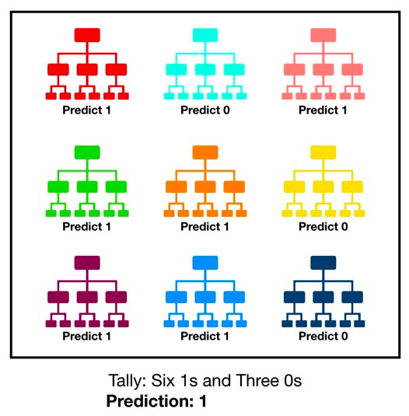
A large number of relatively uncorrelated models (trees) operating as a committee will outperform any of the individual constituent models

Slide 13
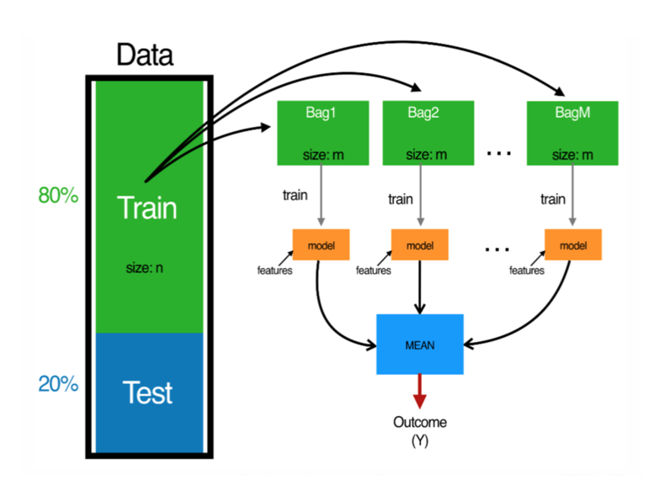
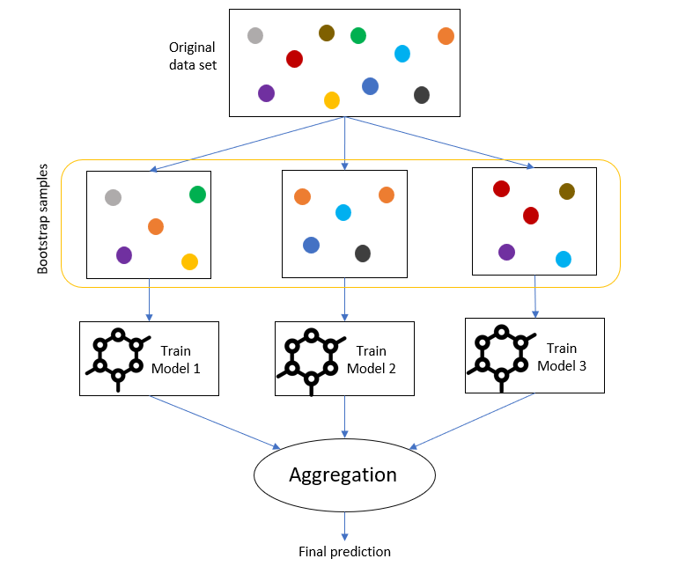

Slide 14
Random Forest pseudocode:
Randomly select “k” features from total “m” features.
Where k << m
Among the “k” features, calculate the node “d” using the best split point.
Split the node into daughter nodes using the best split.
Repeat 1 to 3 steps until “l” number of nodes has been reached.
Build forest by repeating steps 1 to 4 for “n” number times to create “n” number of trees.

Slide 15
Advantages of random forest algorithm
The same random forest algorithm or the random forest classifier can use for both classification and the regression task.
The overfitting problem will never come when we use the random forest algorithm in
any classification problem.
The random forest algorithm can be used for feature engineering.
Which means identifying the most important features out of the available features from the training dataset.

Slide 16
Boosting is an ensemble technique that attempts to create a strong classifier from a number of weak classifiers
This is done by building a model from the training data, then creating a second model that attempts to correct the errors from the first model. Models are added until the training set is predicted perfectly, or a maximum number of models are added.
AdaBoost was the first really successful boosting algorithm developed for binary classification and later on extended to multiclass problem. It is the best starting point for understanding boosting.
AdaBoost can be used to boost the performance of any machine learning algorithm. It is best used with weak learners. These are models that achieve accuracy just above random chance on a classification problem

Slide 17
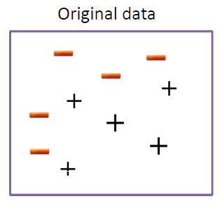
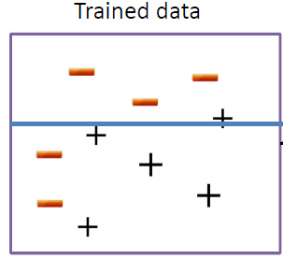
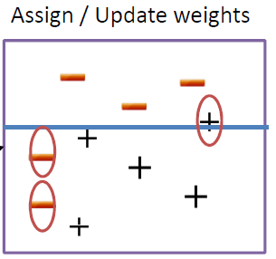
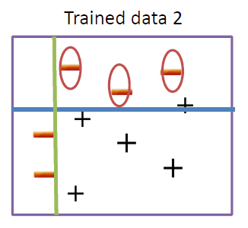
Samples that are incorrectly classified in the kth iteration receives more weights in the (k+1)st iteration, while samples that are correctly classified receives less weights in subsequent iteration

Slide 18
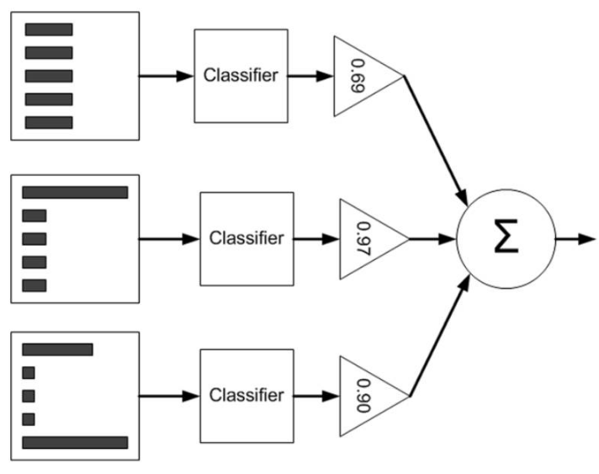
Learning An AdaBoost Model From Data
Output summarization
Each sample have the same starting weight (1/n) initially
Fit a weak classifier using the weighted samples and compute the kth model’s misclassification error (errk)
Compute the kth stage value as ln ((1 − errk) /errk)
Update the sample weights giving more weight to incorrectly predicted samples and less weight to correctly predicted samples

Slide 19
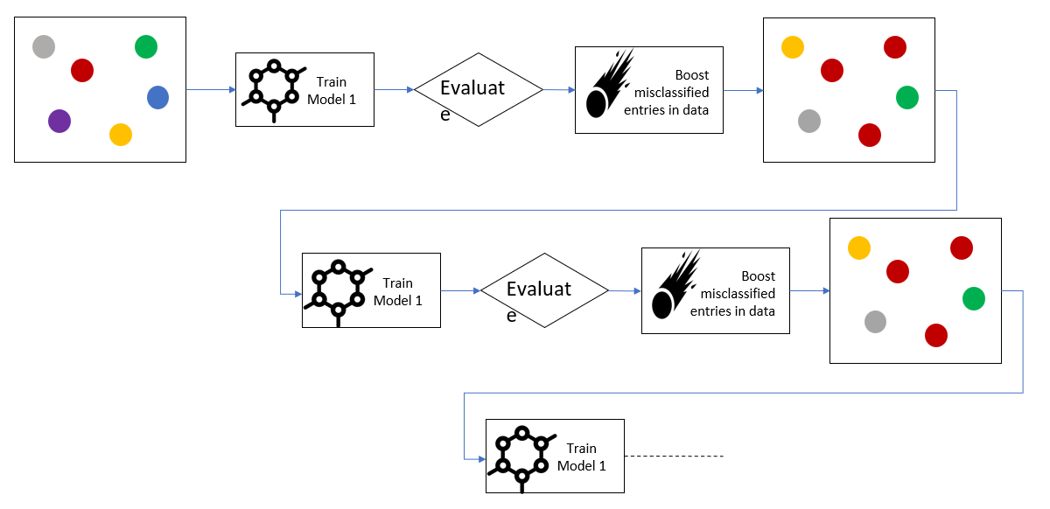

Slide 20
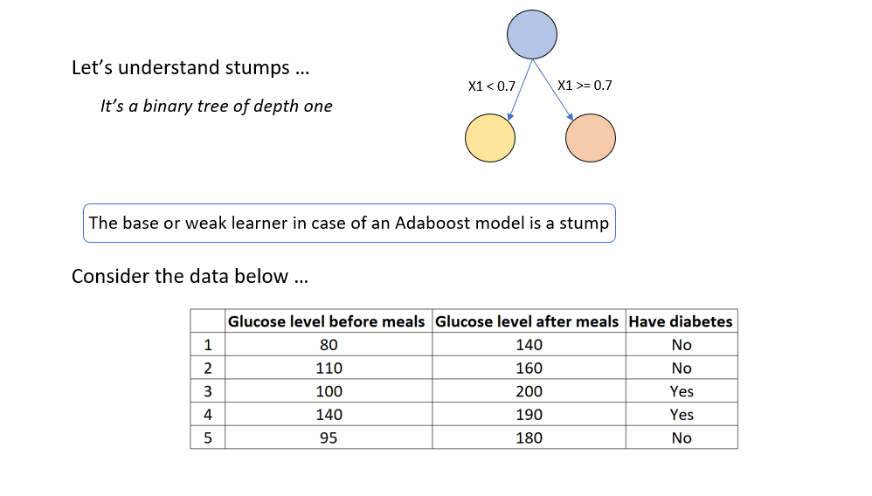

Slide 21
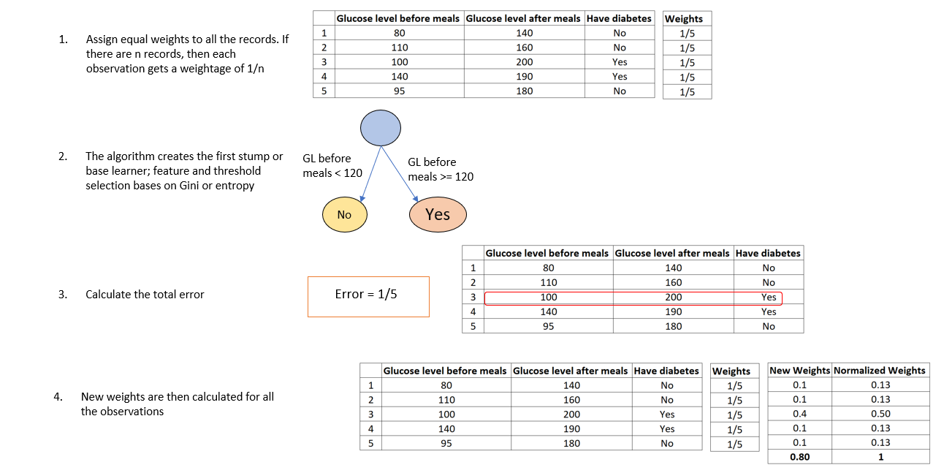

Slide 22
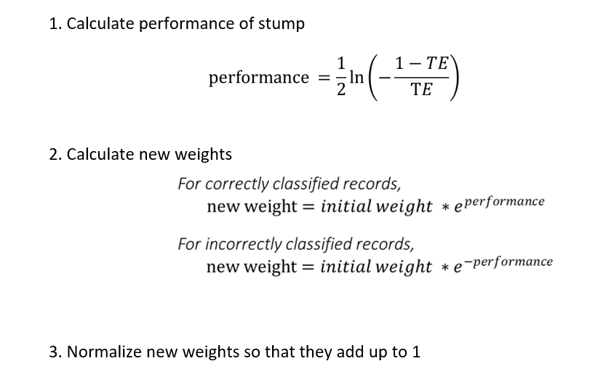

Slide 23
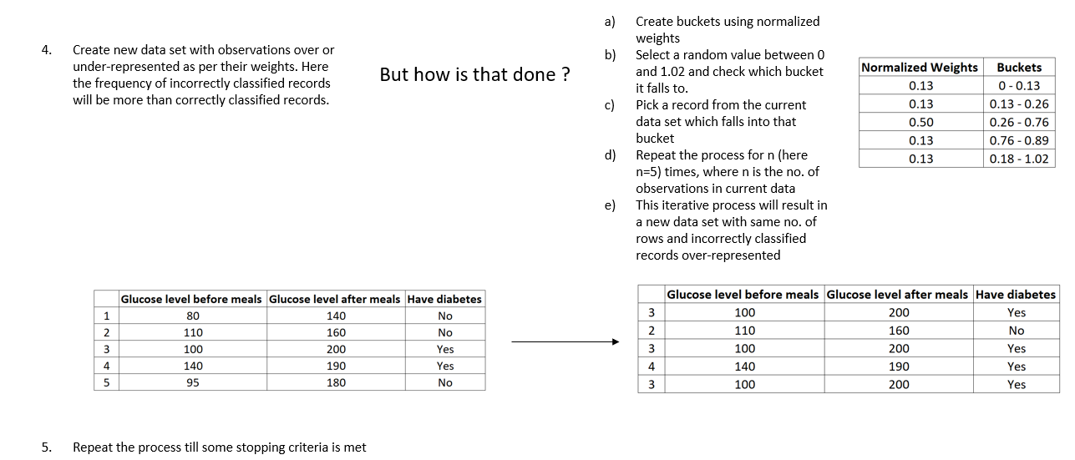

Slide 25
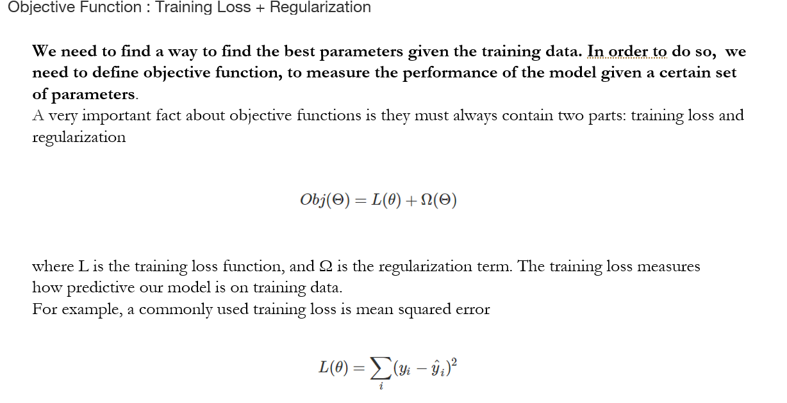

Slide 26
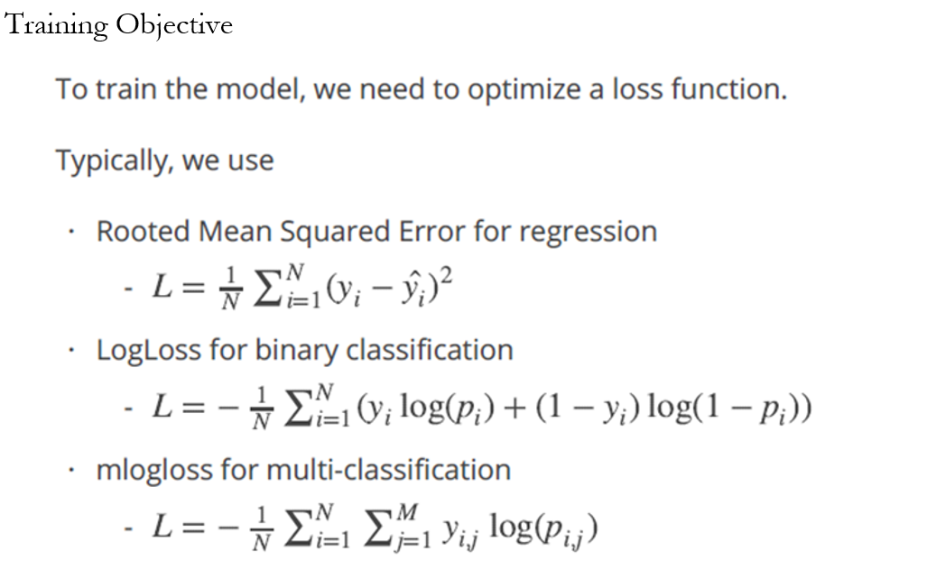

Slide 27
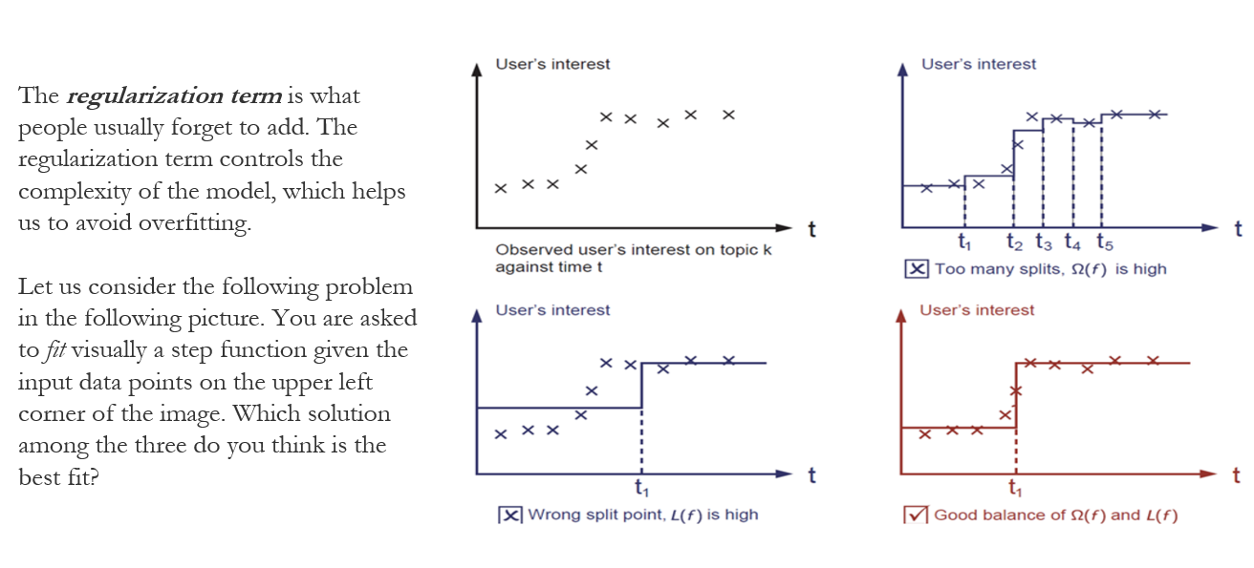

Slide 28
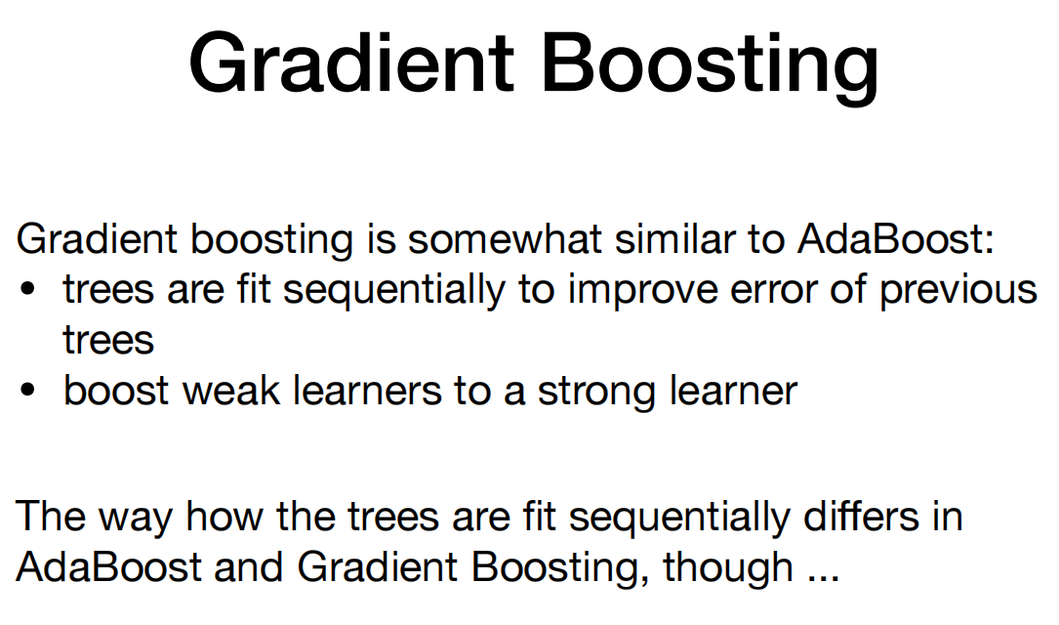

Slide 29
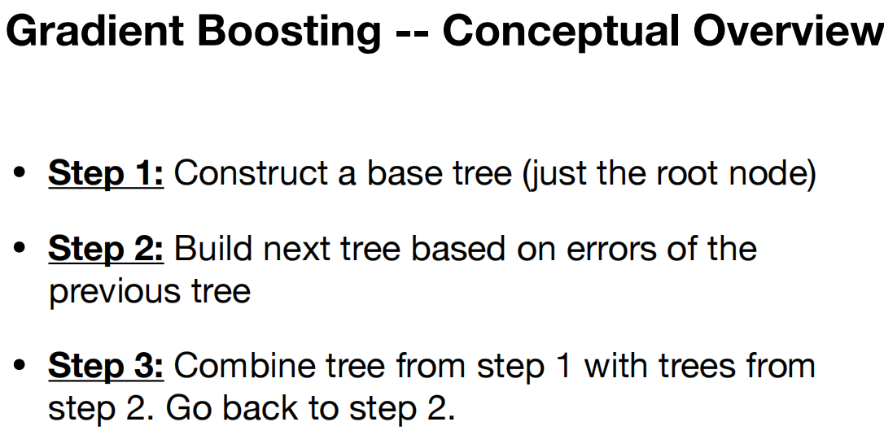

Slide 30
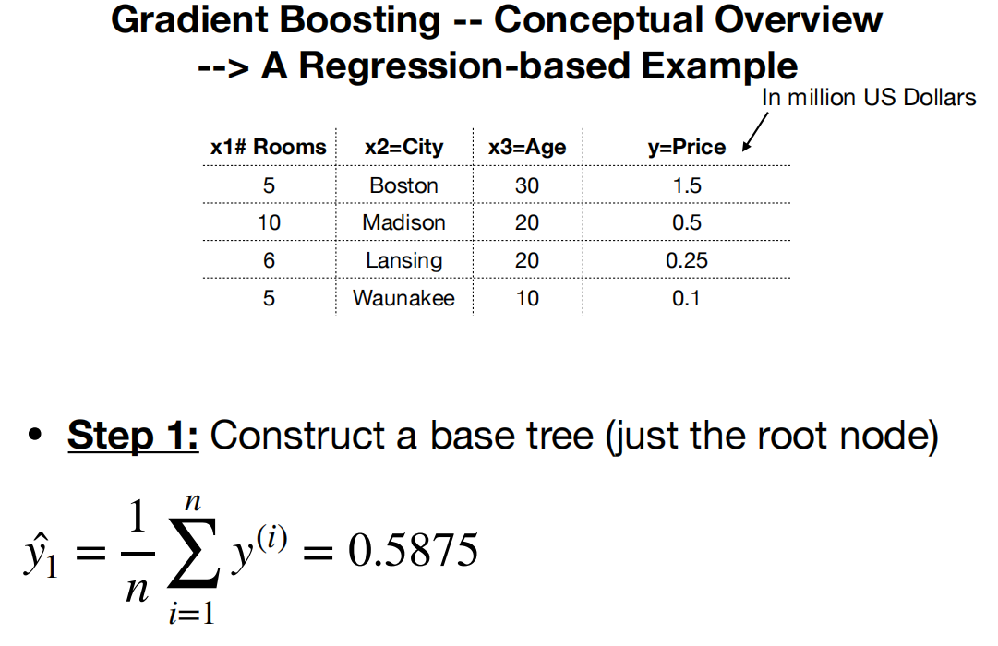

Slide 31
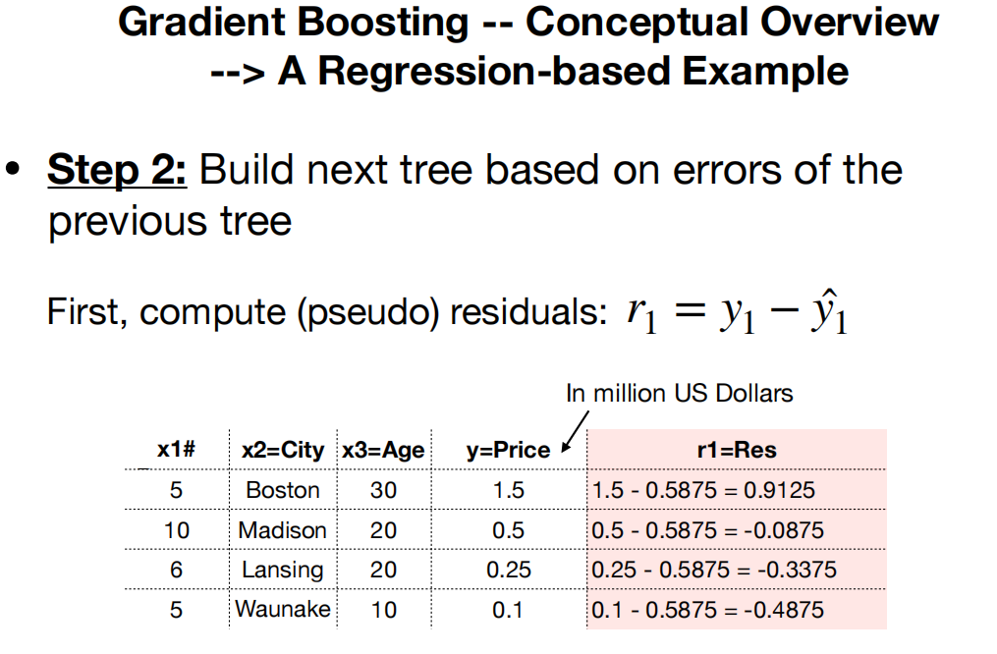

Slide 32
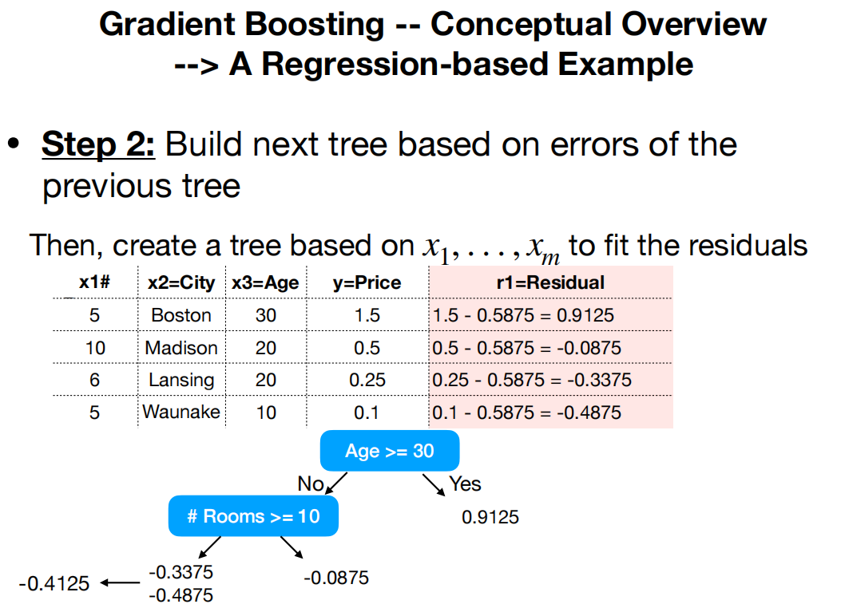

Slide 33
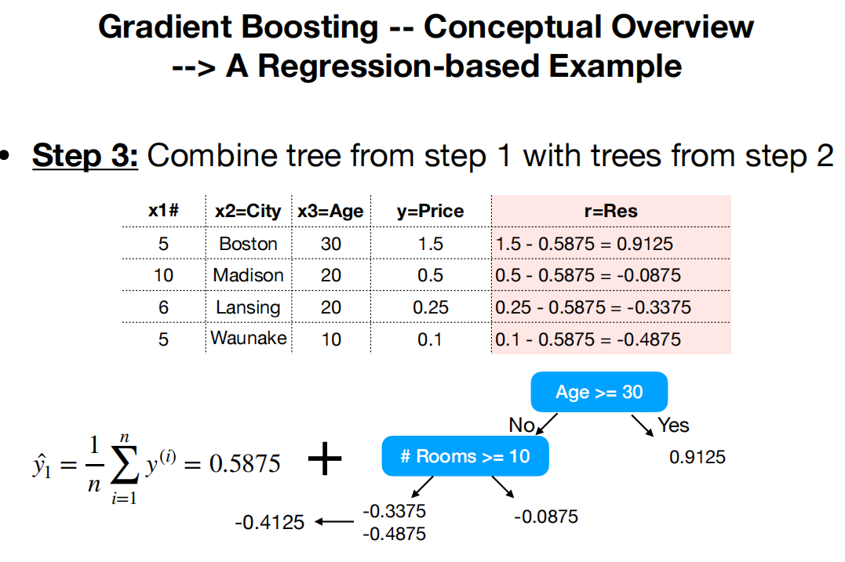

Slide 34
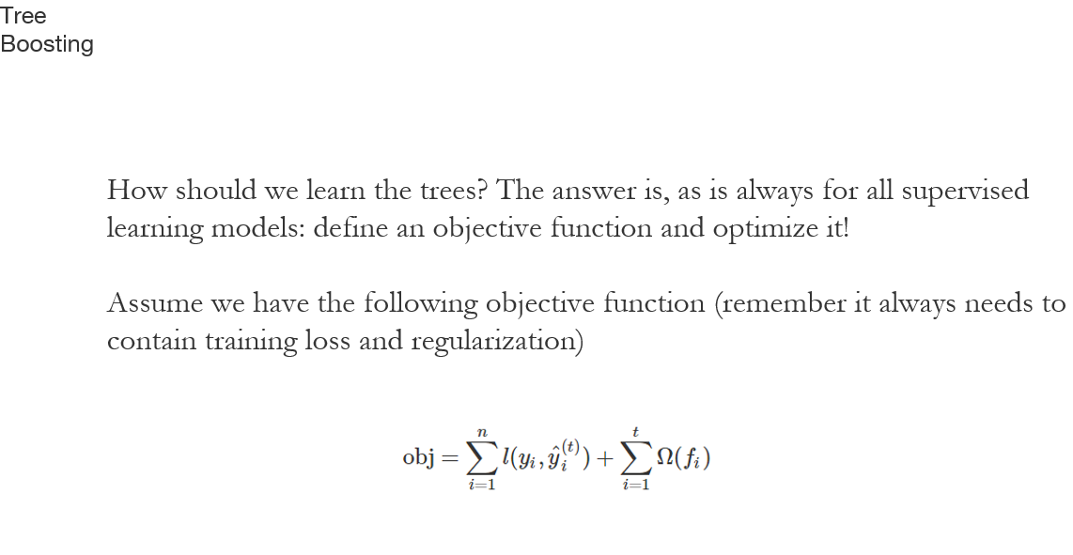

Slide 35
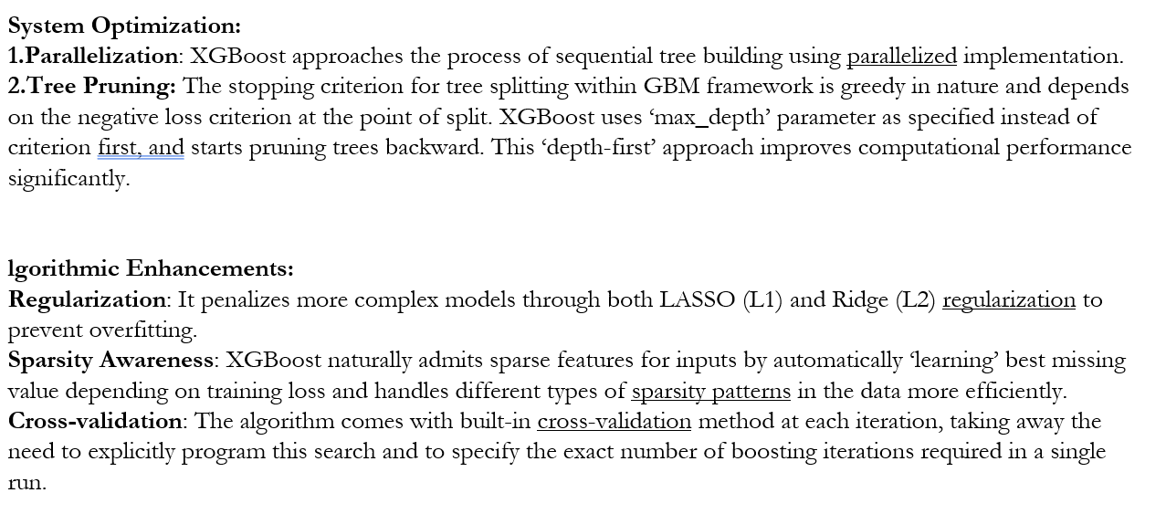

Slide 36
Stacking

Slide 37
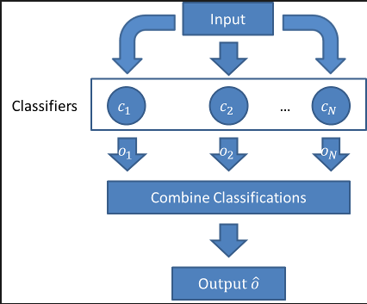
Stacking. Building multiple models (typically of differing types) and supervisor model that learns how to best combine the predictions of the primary models.

Slide 38
Thank you

